Slide 1

P peline
The Data
Case Study: Location
© Jennifer Mankoff
The Data Pipeline; HCII; Spring 2014

Slide 2
Goals
After this, you should be able to:
Understand how data cleaning plays out in the context of a specific case study
Explain an iterative process that can be helpful in cleaning data
Adapted from http://www.fordham.edu/economics/Vinod/correl-regr.ppt

Slide 3
Four Data Sets
 | Augsburg Occupancy | CMU Occupancy | UCSD Movement | CMU Movement
Collection Method | Smart Door Plate | BACNet Sensor Queries | PDA-based WiFi triangulation | Phone-based WiFi Triangulation
Frequency | Every Room Change | Every 10 minutes | Every 20 sec | Every 30 sec, while movement is detected
Flaws | Summer and Fall data sets 4 month apart
Room vs. Floor vs. Campus | Covers 1 floor in an office building | Covers every floor in one university office building | Covers several campus buildings | Covers every floor in one university office building
Type | Transitional | Occupancy | Tracking | Tracking

Slide 4
Four Data Sets
 | Augsburg Occupancy | CMU Occupancy | UCSD Movement | CMU Movement
Scope | 4 People, (summer + [break] + fall) | 300 data points per day per room (temp & occupancy) | 275 students, M=11 weeks | 6 People
Total locations | 15 | 293 Rooms | 200 | 2074 (10x10 meter segments)
Days | M=23.25 (SD 3.42) | M=188.65 (SD 4.3) | M=25.56 (SD 20.81) | M=58.1 (SD 32.57)
Data points per person/day | M=316.60 (SD 8.55) | N/A | M=508.46 (SD 739.1) | M=497.65 (SD 273.96)
Locations per person/day | M=6.70 (SD 0.70) | N/A | M=3.45 (SD 2.68) | M=44.97 (SD 10.67)

Slide 5
A process for data cleaning
Define & Identify
Detect & Quantify
Detection Algorithms
Quantify Prevalence
Types of Glitches
Importance of Glitches
Clean & Rectify
Develop Strategies
Measure & Verify
Repair
Measure Improvements
Tolerance, cost & bias criteria

Slide 6
A process for data cleaning
Define & Identify
Detect & Quantify
Detection Algorithms
Quantify Prevalence
Types of Glitches
Importance of Glitches
Clean & Rectify
Develop Strategies
Measure & Verify
Repair
Measure Improvements
Tolerance, cost & bias criteria

Slide 7
Completeness?
Augsburg Occupancy:
Due to the smart doorplate only transitional data from one space to another is available.
The summer and fall data sets are nearly four month apart. Problem?
Notes:
Some glitches are difficult to define (or correct)
University schedules change a lot … maybe really be two separate data sets.

Slide 8
Completeness?
UCSD Movement:
The number of data points were not equally distributed over all user, some left their device on all the time, but others only collected one days worth of data
All data sets:
Some locations have much more data than others
Issue: is skew a glitch or a feature?
Notes:
Others are quantifiable

Slide 9
A process for data cleaning
Define & Identify
Detect & Quantify
Detection Algorithms
Quantify Prevalence
Types of Glitches
Importance of Glitches
Clean & Rectify
Develop Strategies
Measure & Verify
Repair
Measure Improvements
Tolerance, cost & bias criteria

Slide 10
How to detect and quantify skew?
A vector denoting presence/absence/percentage of data in each entity (location/person) ➔ glitch signature
Outlier detection techniques
Summary statistics
Graphs and Charts
Notes:
A value dij ∈ D is “clean” if and only if every value in vij is zero, that is the sum of the bits is 0. Glitch signatures can be considered augmented or derived data that enable us to flag glitches, quantify their prevalence, and identify patterns in an analytic, automated fashion.

Slide 11
Example: Graph of prime locations
Notes:
What do you notice?
The most frequent location (Top 1) constitutes 50% of the data
Is this what we expect?

Slide 12
UCSD Data Set Skew

Slide 13
Example: UCSD Data Set

Slide 14
Example: UCSD Data Set

Slide 15
Example: Summary of UCSD data
7 out of the 275 users combined 21.4% of the whole data set.
Notes:
Data is very uneven. This is probably something we want to continue paying attention to.

Slide 16
A process for data cleaning
Define & Identify
Detect & Quantify
Detection Algorithms
Quantify Prevalence
Types of Glitches
Importance of Glitches
Clean & Rectify
Develop Strategies
Measure & Verify
Repair
Measure Improvements
Tolerance, cost & bias criteria

Slide 17
How do we address missing values?
Imputation
Replace missing values with a statistical estimate (e.g., mean). Could be most common zipcode in explore.py for zips
Replace missing value with a predicted value. This could be based on logic (e.g., derive zip from lat/lon), or classification
Replace missing value with a default. 0 was my default solution in explore.py

Slide 18
How do we address extreme values?
Outlier Treatment
Can drop them
Winsorization (replace with a less extreme value)
Replace missing value with a default. 0 was my default solution in explore.py
De-Duplication
Domain-based adjustments

Slide 19
Develop Strategy to Fix Glitch
Remove people who generated extreme amounts of data (= 7 users; 21% of data)
Recalculate mean (= 638.7 data points/person)
Remove people who generated < mean data points

Slide 20
A process for data cleaning
Define & Identify
Detect & Quantify
Detection Algorithms
Quantify Prevalence
Types of Glitches
Importance of Glitches
Clean & Rectify
Develop Strategies
Measure & Verify
Repair
Measure Improvements
Tolerance, cost & bias criteria

Slide 21
Did we improve things?
Compare glitch index (sum of glitch signature) before and after
Check for statistical distortion (measure the distance from D to D*

Slide 22
Remaining data
86 users
85.8% of the data set
Here we aimed to create a distortion in which each remaining user was associated with a significant percentage of the data.

Slide 23
Coherence
Expected indoor temperature to conform to a “comfortable” range”
Notes:
Indoor temperature data for Gates building
Expect to find temperature in fahrenheit like first example BUT
Data showed missing values such as example 2 (possible sensor errors, no connection to the sensor, transmission errors, etc.)
But also unlikely values such as example 3 are present

Slide 24
Coherence
Expected indoor temperature to conform to a “comfortable” range”
VAV Room 5701 : 70.70:1313863526.19:2011-08-20 14-05-26
VAV Room 5703 : ?:1313863526.19:2011-08-20 14-05-26
Data Center CRAC-1 : 0.00:1313863537.71:2011-08-20 14-05-37`
Notes:
Indoor temperature data for Gates building
Expect to find temperature in fahrenheit like first example BUT
Data showed missing values such as example 2 (possible sensor errors, no connection to the sensor, transmission errors, etc.)
But also unlikely values such as example 3 are present

Slide 25
Coherence
Expected indoor temperature to conform to a “comfortable” range”
VAV Room 5701 : 70.70:1313863526.19:2011-08-20 14-05-26
VAV Room 5703 : ?:1313863526.19:2011-08-20 14-05-26
Data Center CRAC-1 : 0.00:1313863537.71:2011-08-20 14-05-37`
Notes:
Indoor temperature data for Gates building
Expect to find temperature in fahrenheit like first example BUT
Data showed missing values such as example 2 (possible sensor errors, no connection to the sensor, transmission errors, etc.)
But also unlikely values such as example 3 are present

Slide 26
Example: Movement Data Coherence
Define & Identify
Detect & Quantify
Clean & Rectify
Measure & Verify
Expectation that office worker spend large chunks of the day not moving at one location

Slide 27
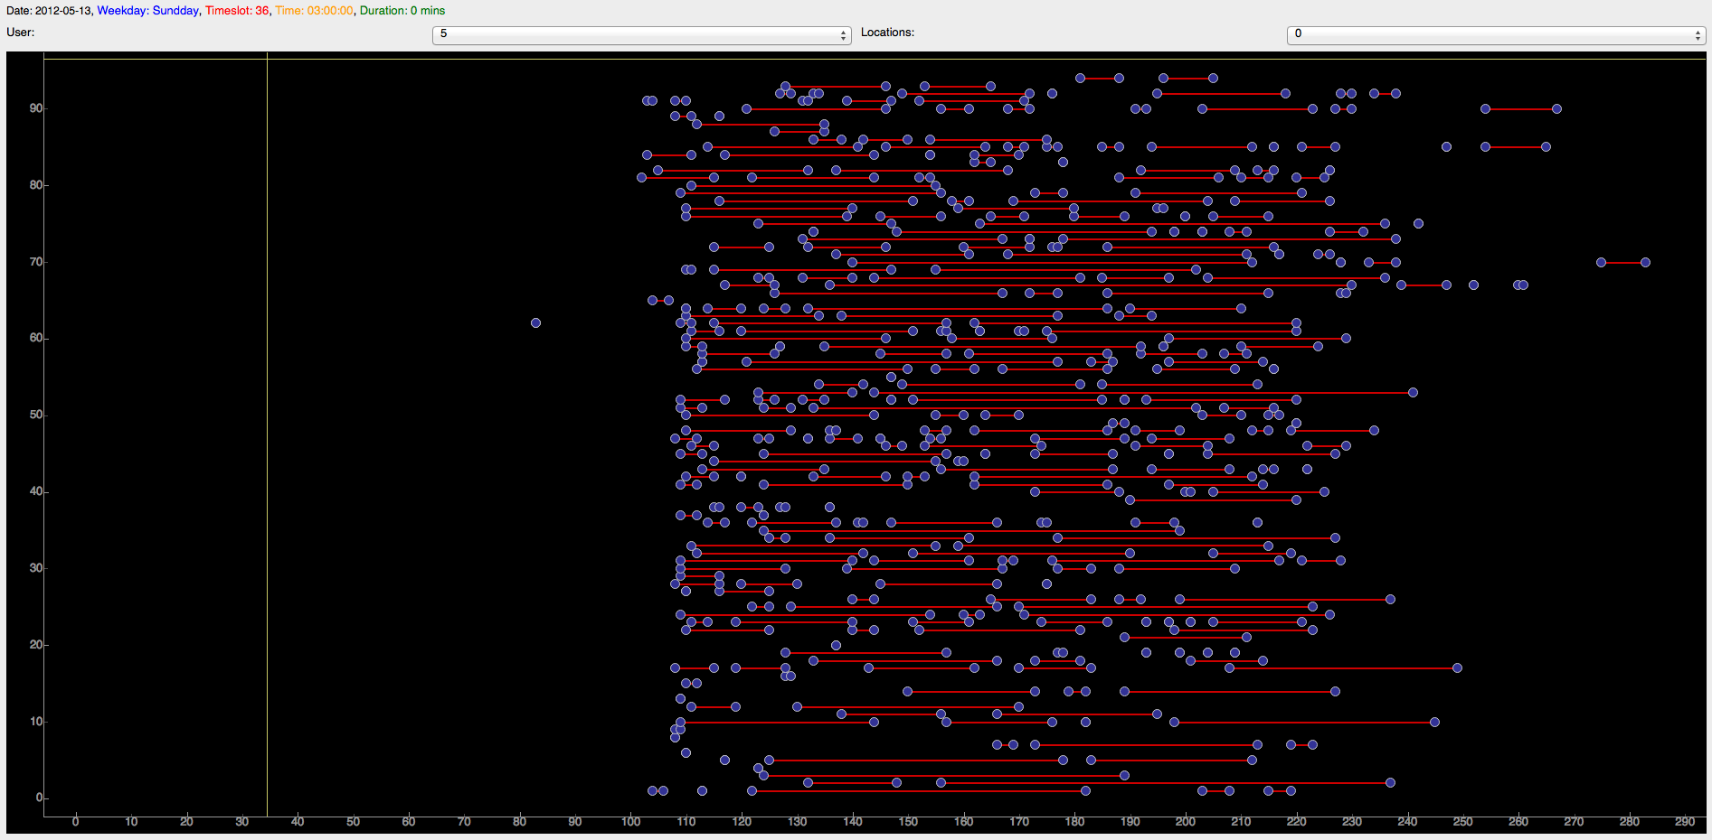
Movement Analysis Revealed Problems
Define & Identify
Detect & Quantify
Clean & Rectify
Measure & Verify
GHC Data movement analysis for one user over several days
Notes:
Each y-coord is a new day
X-coord is the time of day in 5-minute time slots
Lines show continuous movement
Based on data source expected to find little movement for most of the day
the errors in the labeling algorithm and insufficient map data resulted in barely any stationary locations

Slide 28
How we calculate movement data
Collect WiFI samples throughout Gates
Calculate Mean WiFi Profiles
Compare Movement Data to Profiles

Slide 29
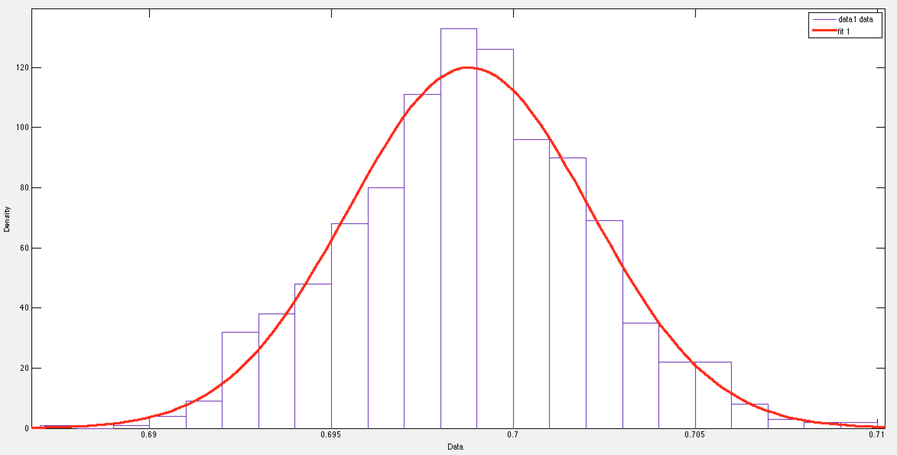
Signal Strength Distribution should be Normal
Signal Strength Distribution for Single Access Point in Gates Hillman Center
Notes:
Indoor location tracking in Gates Hillman Center relied on assumption that signal strength variations of each access point is normally distributed
Analysis of randomly selected Access Points showed normal distribution

Slide 30
Further diagnosis is needed
We suspected errors in the labeling of indoor location tracking data
We collected continuous data from a fixed location over several days
Results show that the algorithm we used produced a very high error

Slide 31
Solution: New Algorithm
Define & Identify
Detect & Quantify
Clean & Rectify
Measure & Verify
Collect WiFI samples throughout Gates
Calculate Mean WiFi Profiles
Compare Movement Data to Profiles

Slide 32
Correctness
Define & Identify
Detect & Quantify
Clean & Rectify
Measure & Verify
Notes:
Compared to an alternative algorithm
Original Algorithm: Mean 16.29 m, Std 4.78 m
Alternative Algorithm: Mean: 5.58 m Std 3.50 m

Slide 33
Is Statistical Distortian an Issue?
Define & Identify
Detect & Quantify
Clean & Rectify
Measure & Verify
Notes:
No because we were correcting an outright error in the data

Slide 34
What we learned from case study
Many ways to phrase the ‘prediction’ problem
Major problems with quality in published data sets

Slide 35
Summary of Techniques Discussed
How to detect and quantify errors?
Glitch signature
Summary statistics
Graphs and Charts
Specific things to look for
Outlier detection techniques
Skew
Techniques for fixing
Imputation
Winsorization
De-Duplication
Domain specific approaches
Define & Identify
Detect & Quantify
Clean & Rectify
Measure & Verify

